Slide 1


Department Of Mechanical Engineering
FINAL YEAR INTERNSHIP PRESENTATION ON
PUMP MAINTENANCE
Under the guidance of
Prof. N. A. KADAM
Presenters
Deshmukh Himanshu Sunil Syed Abdul Aleem Sufyan
Rollno. 11 Rollno. 59

Slide 2
Contents
Introduction
Company Profile
Vertical Turbine Pump
Pump House
Maintenance
On-site
Workshop
Troubleshooting
Learnings Derived
CONTENTS
2

Slide 3

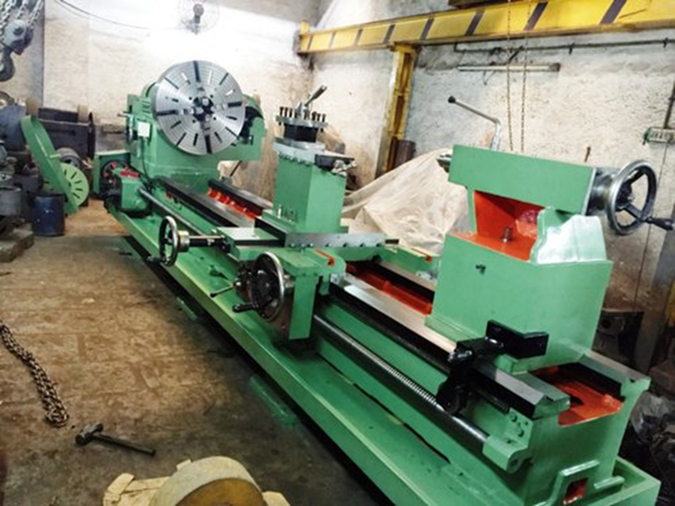
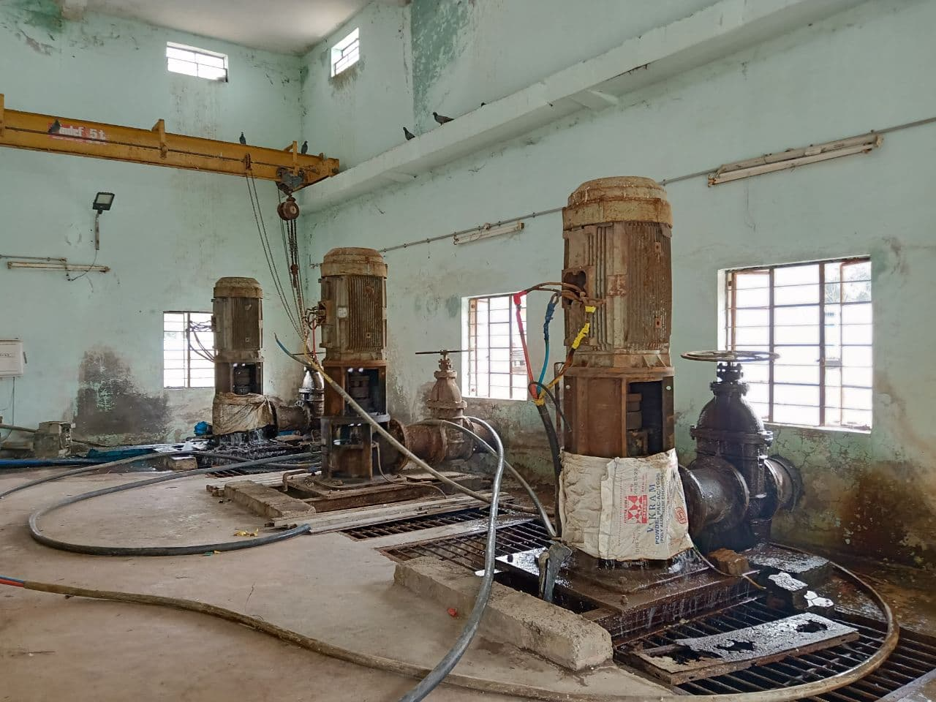
INTRODUCTION
Unique Engineering & Mechanical Works Ltd. Station Road Nanded (M.S) – 431 601 GSTIN-27ALDPM4255F1Z6
Company Profile
Unique Engineering & Mechanical Works established in 2006, offers service to Nanded city and its nearby localities of all sizes for their municipal water systems, be it potable or sewage pump.
Their local repair facility is available for quick and reliable repairs of municipal pump systems. They offer on-site repairs as well as pick up and reinstallation of pump equipment to be repaired at shop.
3
Notes:
3

Slide 4
Services Offered
Unique Engineering & Mechanical Works offers repair and rebuild services for vertical turbine pumps and motors in the Nanded area.
Vertical Turbine Pump Repair Services:
Onsite troubleshooting
Removal of Vertical Turbine Pump from jobsite (If required)
Complete disassembly and inspection including non-destructive testing and precise measuring
Bead blasting and thorough cleaning of all Vertical Turbine pump components and parts
Vertical Turbine Pump parts fabrication or rebuilt (As necessary)
Shaft repairs and replacement to manufacturers specifications
Impeller trim and precision balancing
Special Coatings
Machine shop fully equipped providing professional rebuild capabilities
Motor analysis, rebuild, repairs and replacements
Reassembly
Delivery and installation as requested
5

Slide 5
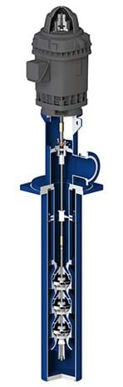
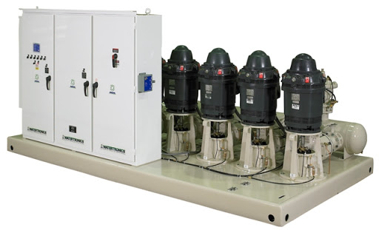
VERTICAL TURBINE PUMP
Vertical turbine pumps (VTPs) are a type of rotodynamic pump that use radial or modified radial flow impellers in a vertical configuration.
These pumps transport water to treatment plants, irrigation sprinklers and to faucets in homes.
Another unique application of a VTP is that the pump can be run in reverse and be used as a hydraulic turbine to generate power.
Vertical turbines are commonly used in all types of applications, from moving process water in industrial plants to providing flow for cooling towers at power plants, from pumping raw water for irrigation, to boosting water pressure in municipal pumping systems, and for virtually every other imaginable pumping application.
Turbines are one of the most popular types of pumps for designers, end-users, installing Contractors, and distributors.
6

Slide 6
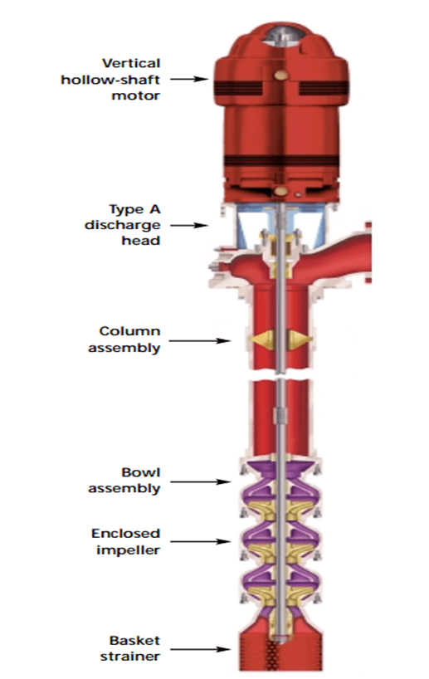
VERTICAL TURBINE PUMP
Turbine pumps has got three distinct sections
Bowl assembly
Column assembly
Head assembly
Column Assembly of Turbine Pumps : Column assembly connects the bowl assembly with head assembly and forms a medium for lifting the water up. It comprises of column pipes, shaft assembly and its enclosing tube in case of oil lubricated type of pump.
Head Assembly of Turbine Pumps: The head assembly consists of
Base from which the column, shaft assembly, and bowl assembly are suspended
Discharge-head-elbow which directs water into delivery piping system
Driver or Prime mover which may be Diesel engine or Electric motor
Pump Bowl Assembly: The bowl assembly is the heart of the vertical turbine pump. The impeller and diffuser type casing are designed to deliver the head and capacity that your system requires in the most efficient way possible.
7

Slide 7
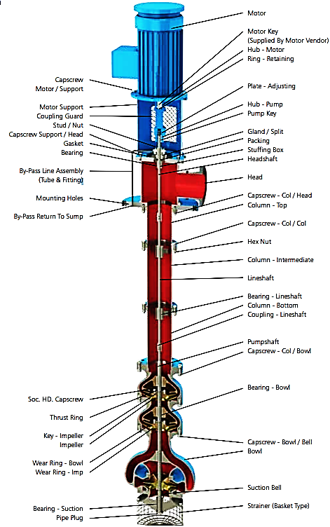
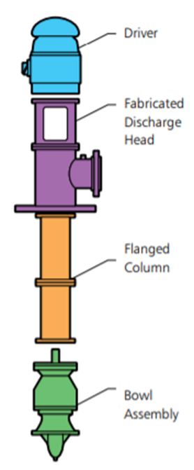
VERTICAL TURBINE PUMP
Cross Sectional
Notes:
7

Slide 8
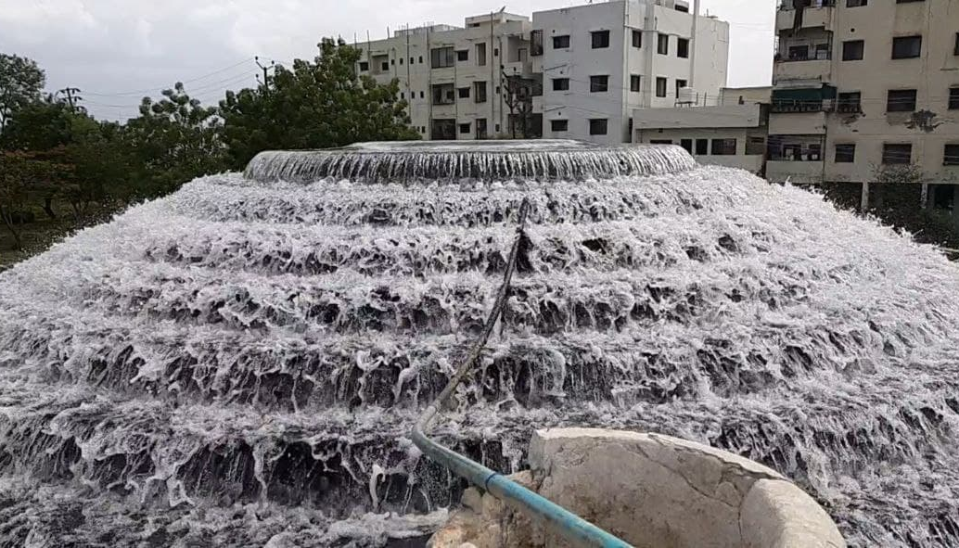
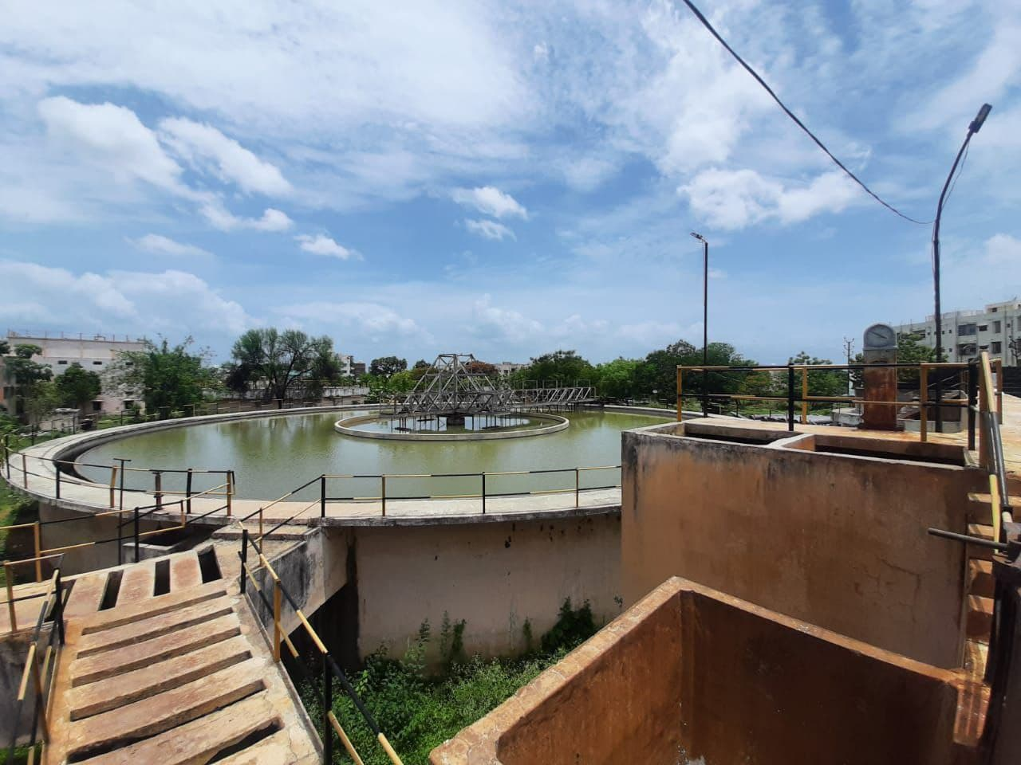
Water Treatment Plant at Kabra Nagar, Nanded
Notes:
8

Slide 9
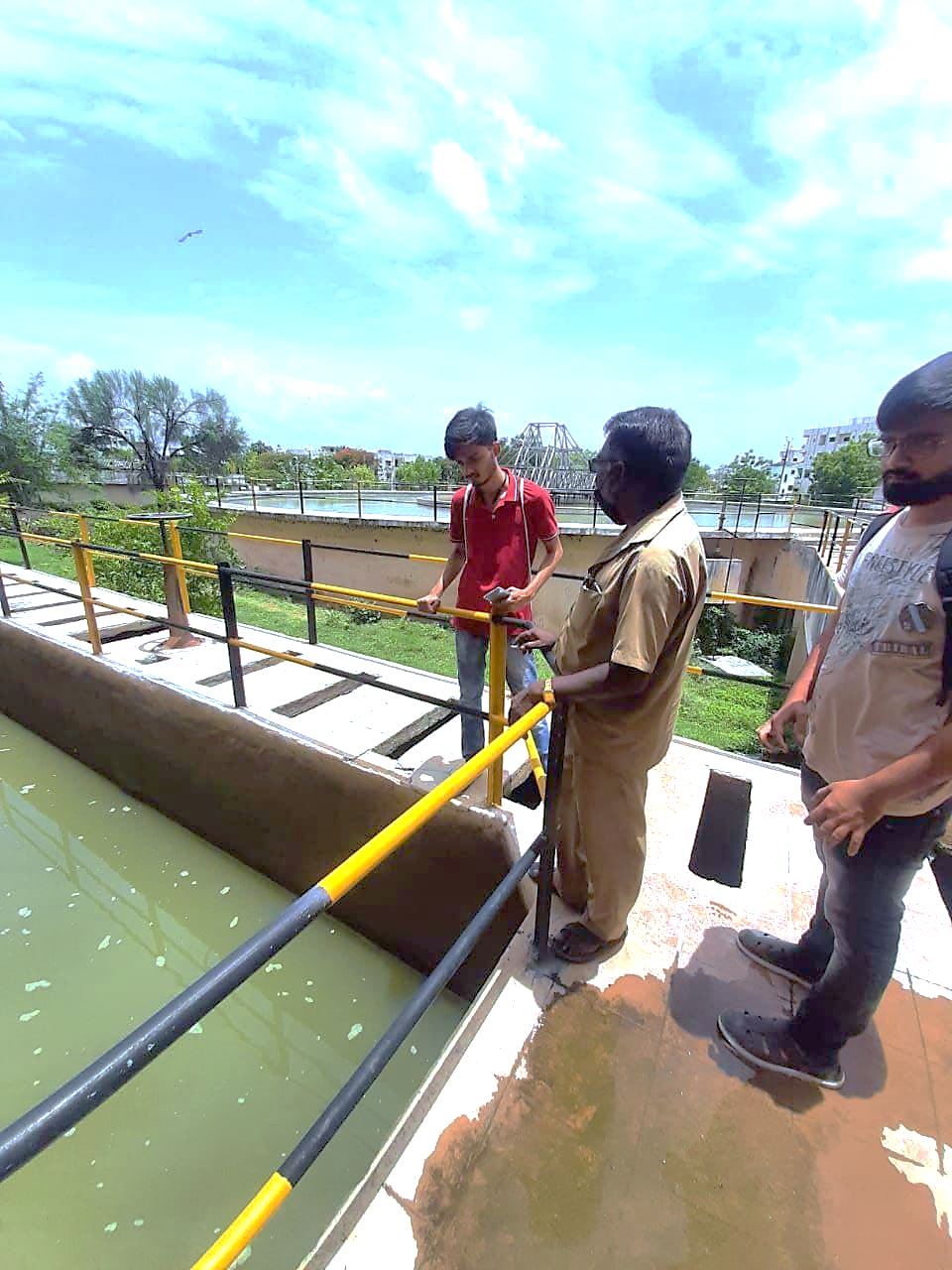
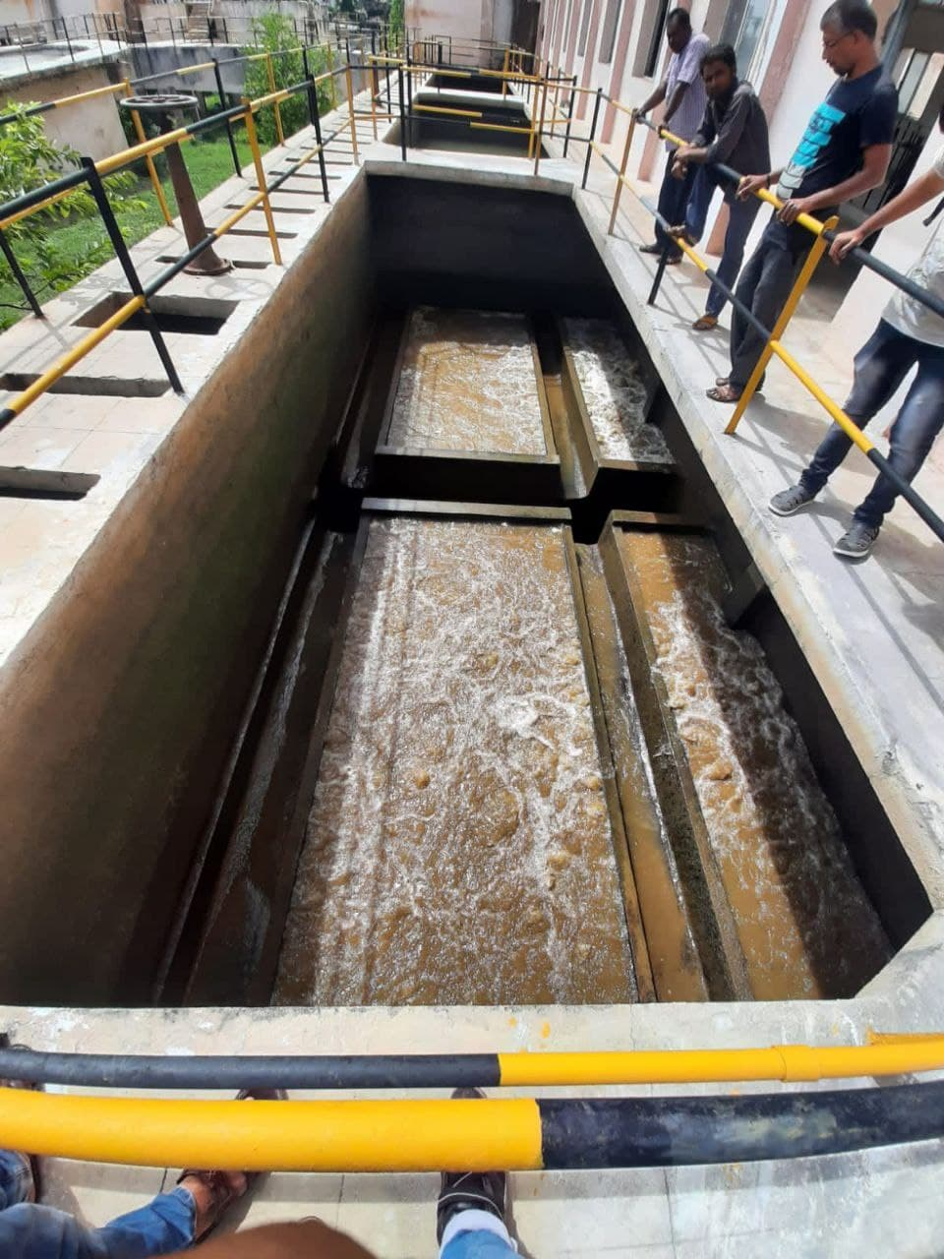
Water Treatment Plant at Kabra Nagar, Nanded
Notes:
9

Slide 10
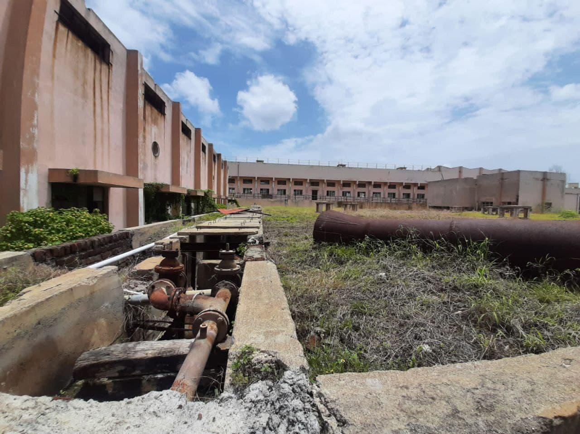
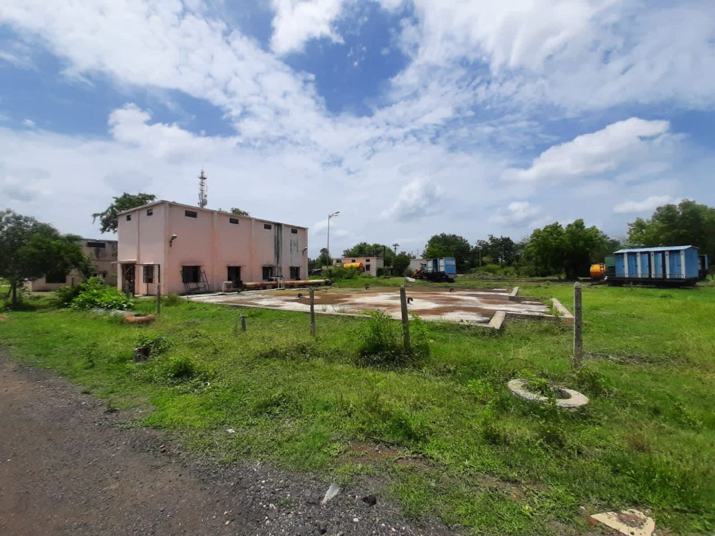
Water Treatment Plant at Kabra Nagar, Nanded
Notes:
10

Slide 11

Water Treatment Plant at Kabra Nagar, Nanded
Vertical Turbine pump in Pump House
Notes:
11

Slide 12
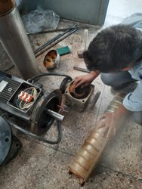
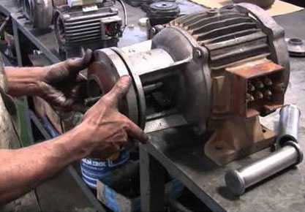
MAINTENANCE
Maintenance of a pump can be divided in two categories-
On-Site Maintenance Workshop Maintenance
9

Slide 13
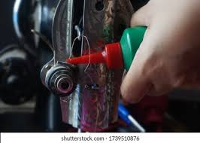
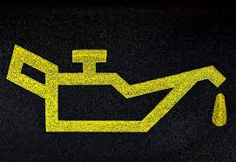
MAINTENANCE
On-Site Maintenance
a. Periodic Maintenance:
A periodic (once a month) detailed inspection is suggested for all units. During this inspection. The pump and driver should be checked for performance and change in noise or vibration level, loose bolts or piping, dirt and corrosion. Clean and repaint all areas that are rusted or corroded.
Periodic maintenance consists of the following.
Packing Box Maintenance: Maintenance of the packing box will consist of greasing the box when required, tightening the packing gland occasionally as the leakage becomes excessive, and installing new packing rings or sets as required.
Greasing The Packing Box: Under ordinary operation once a month greasing of the packing box will be adequate.
9

Slide 14
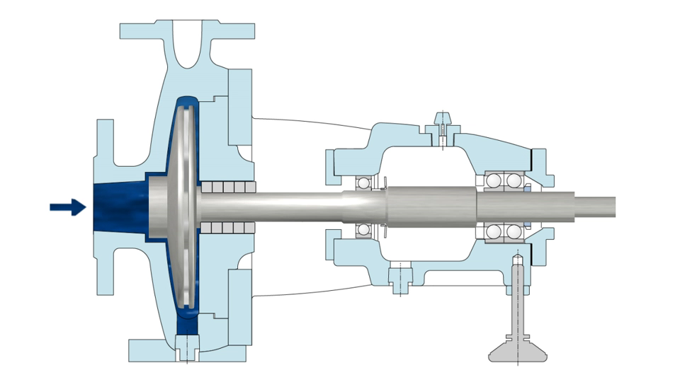
MAINTENANCE
Replacing Packing: Remove gland and all old packing. If the box contains a lantern ring remove this and all packing below it. Inspect shaft or sleeve for score marks or rough spots. Be sure bypass holes (if required) are not plugged.
Mechanical Seal Maintenance: Mechanical seals should not be readjusted. Best results will be obtained if the seal is properly set at start-up and left that way. If the seal starts to leak after an extended operating period some extra service may be obtained by readjusting, however, it is usually best to plan on replacing the seal at the next maintenance period.
Impeller Readjustment: Ordinarily the impeller will not require frequent readjustment if properly set at initial installation. Almost no change in performance can be obtained by minor adjustment of enclosed impellers.
9

Slide 15
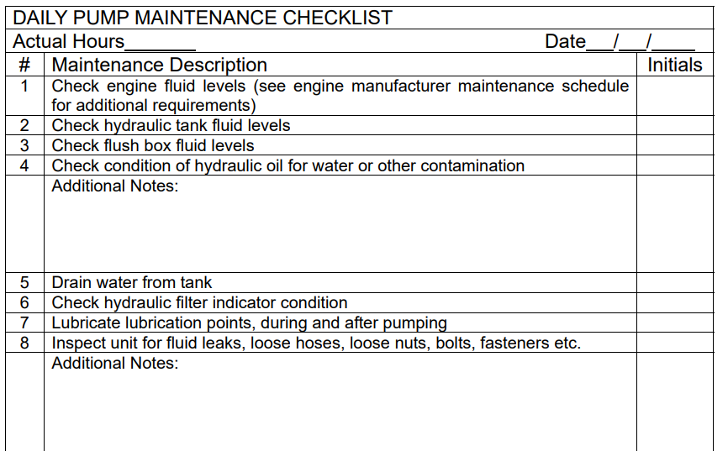
MAINTENANCE
b. Preventive Maintenance :
To ensure satisfactory operation of the pump scheduled inspection and periodic maintenance are required. It is suggested that an inspection and maintenance log be kept and the inspector reports any problems.
9

Slide 16
MAINTENANCE AT WORKSHOP
In some cases, the pump requires intensive repair, which cannot be done on-site and is needed to be carried to workshop. These cases involve wear out, fracture or failure of the parts.
Repairs will consist of removal of the unit and disassembly to the point necessary for replacement of worn parts.
At workshop we used various machines such as Lathe machine, welding machine, drill machine etc. according to the requirement.
21

Slide 17
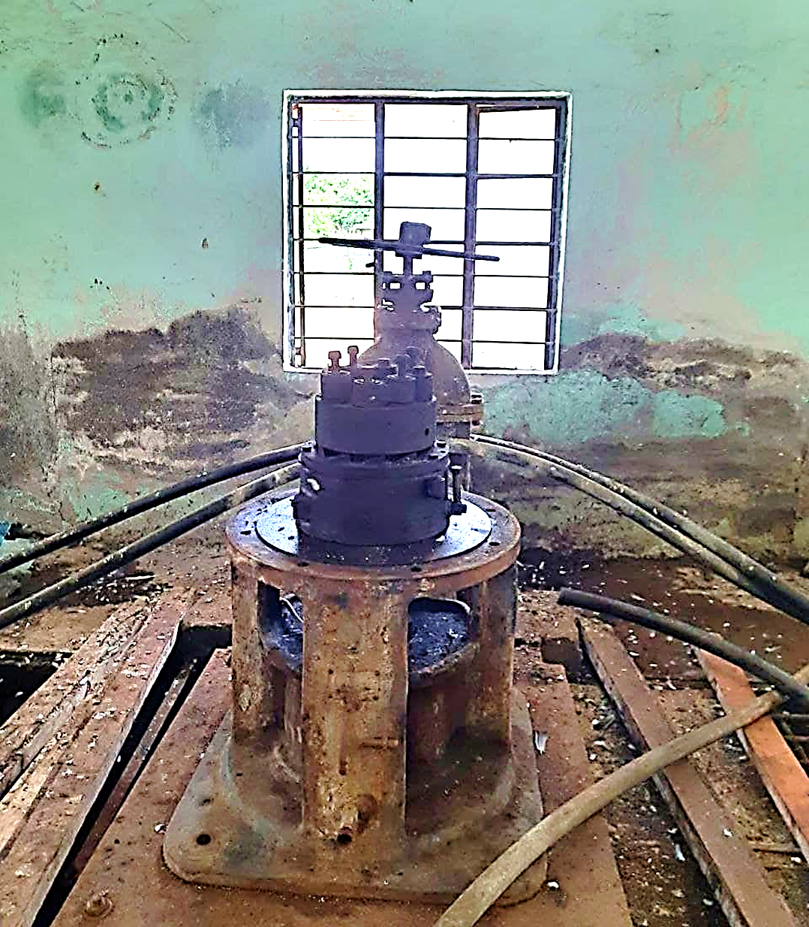
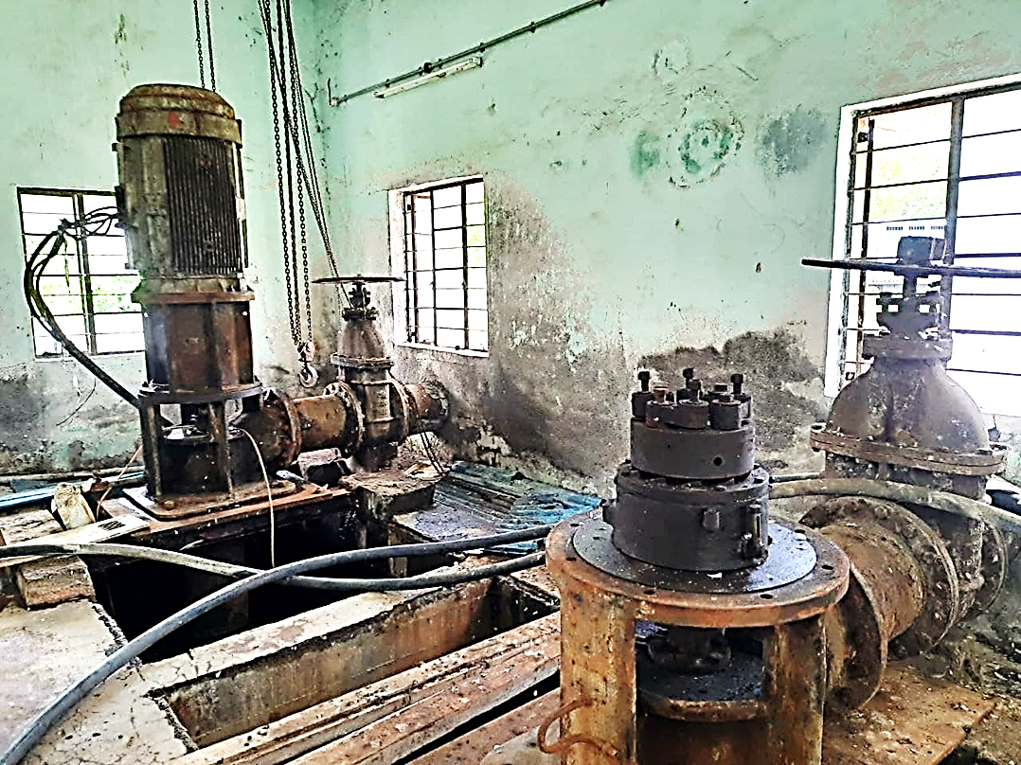
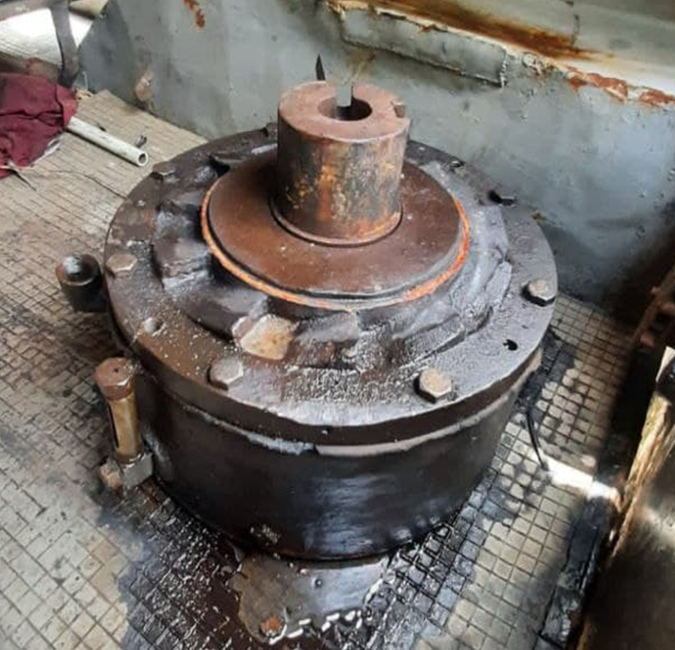
MAINTENANCE AT WORKSHOP
Pump House, Nanded
Motor Dissembled for Maintenance
Bearing Chamber
21

Slide 18
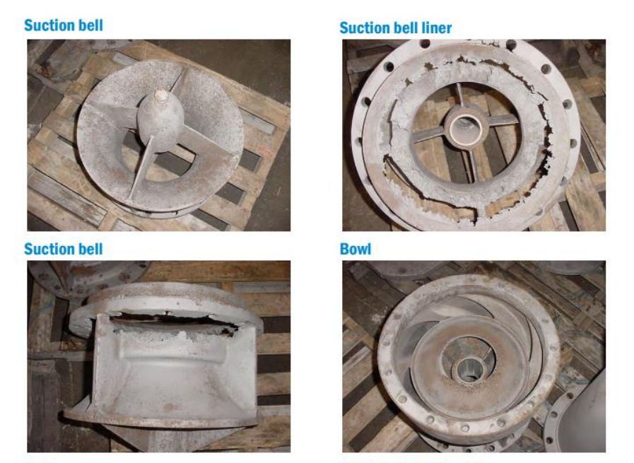
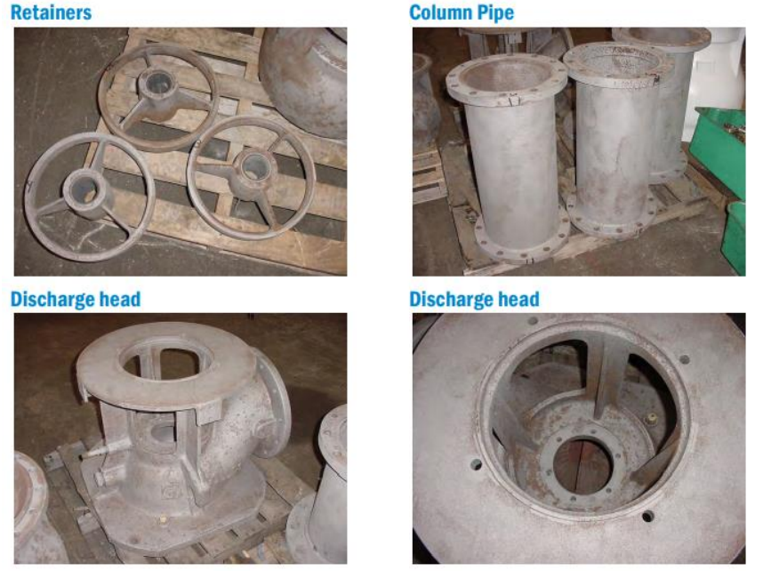
Our work as intern
Inspection
First visual inspection is done of all the parts and the broken and weared out parts are kept aside for repair.
21

Slide 19
2. Joining of broken Impeller shaft
Machines Used: Lathe Machine and Welding Machine
Operations Performed: Turning, Facing, Drilling, Welding, Grinding.
Procedure:
- The face of the broken part is machined on the lathe machine. With the help of turning and facing the broken area is cleaned. Here cast-iron tool is used to complete the job.
- Then taper turning is performed on both the broken ends. -With the help of drill a hole is drilled on both the broken ends. Then a rod of same diameter as that of hole is used to join the shaft.
- Then the gap between both ends is filled with the help of welding, while keeping the shaft fixed in lathe machine. After every round of welding the is rotated for about one minute to make sure the shaft remains straight. The surplus material is then removed by the turning operation.
21

Slide 20
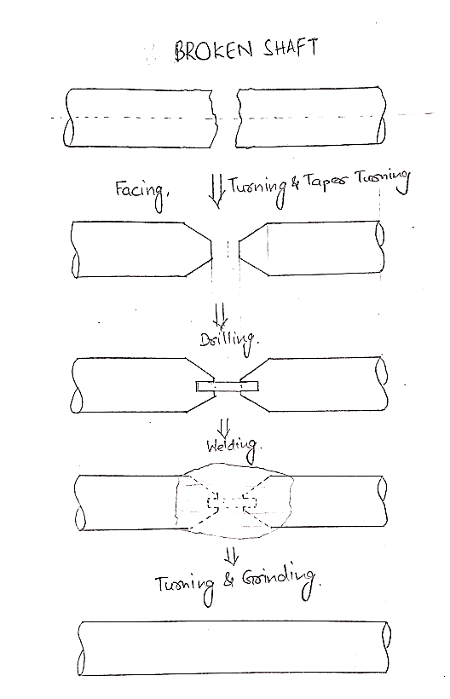
Joining of broken Impeller shaft
21

Slide 21
3. Machining of Coupling And Retainer Bushes
Machines Used: Lathe Machine
Operations Performed: Turning, Facing, Boring, Grinding.
Procedure:
-The couplings and retainer bushes that are to be replaced are removed. Then the required dimensions fir the new coupling and retainers are noted.
Coupling Size: 55 I.D.x65 O.D.x210 Length mm
Retainer size: 45 I.D.x55 O.D.x180 Length mm
Coupling is made of Stainless Steel and retainer is made of Cast-iron,
-The required number of pieces are moulded with a tolerance of 10mm.
-After moulding, the surplus material is removed by facing, turning and boring operation on lathe machine. The feed rate for the coupling is kept low while for the retainers, it is performed on high speed.
-Then threading is done on coupling on the inner surface.
21

Slide 22
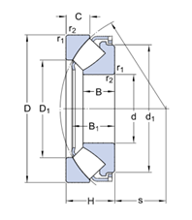
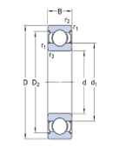
4. Cleaning Of Bearing Chamber and Replacing Bearings
The bearing chamber is cleaned with diesel and dry clothes. One must make sure that no residue or sand particles goes in bearing chamber since it can damage bearings.
Then the ball bearing and the Spherical roller thrust bearing are removed and replaced with new ones.
Bearings Used : Ball Bearing No. 6020
Spherical Roller Thrust Bearing No. 29418
21

Slide 23
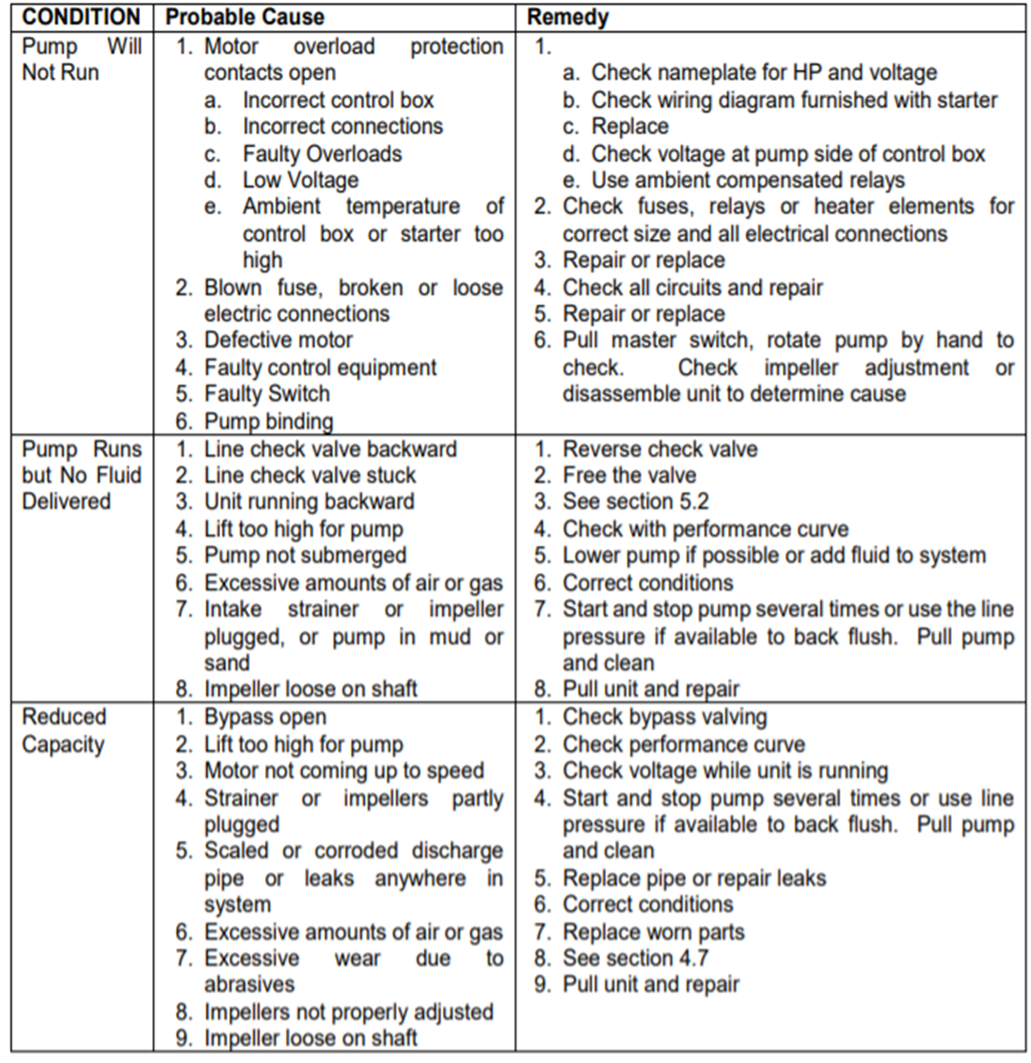
TROUBLESHOOTING
Problems with pumping equipment causes not only inconvenience, but can also contribute to loss of functioning. An efficient operation depends on trouble-free pumping.
The following listed problems that often occur with pumps with probable symptoms and the possible causes pertaining to them-
21

Slide 24
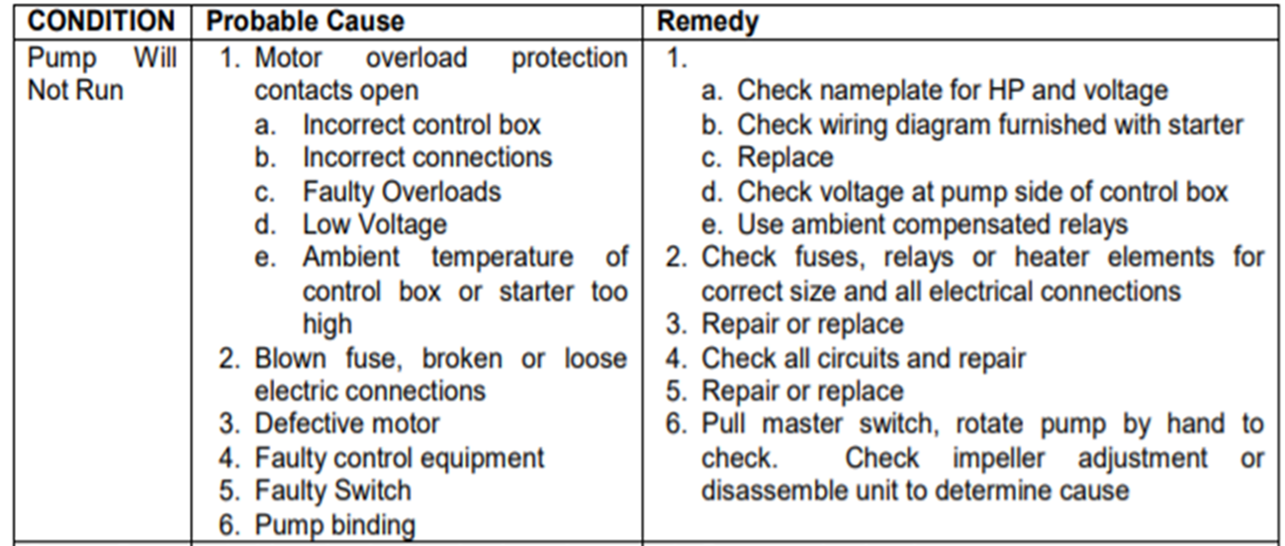
TROUBLESHOOTING
21

Slide 25
Learnings derived from the internship
This internship have introduced us to a lot of useful resources and have given us the opportunity to meet a variety of professionals.
We learned the water management and distribution carried out at municipal level.
We got opportunity to follow practical approach and apply our theoretical learnings from academics.
Discussion with authorities over remote monitoring of the machineries' health.
21

